Slide 1

Unit 10

Slide 2
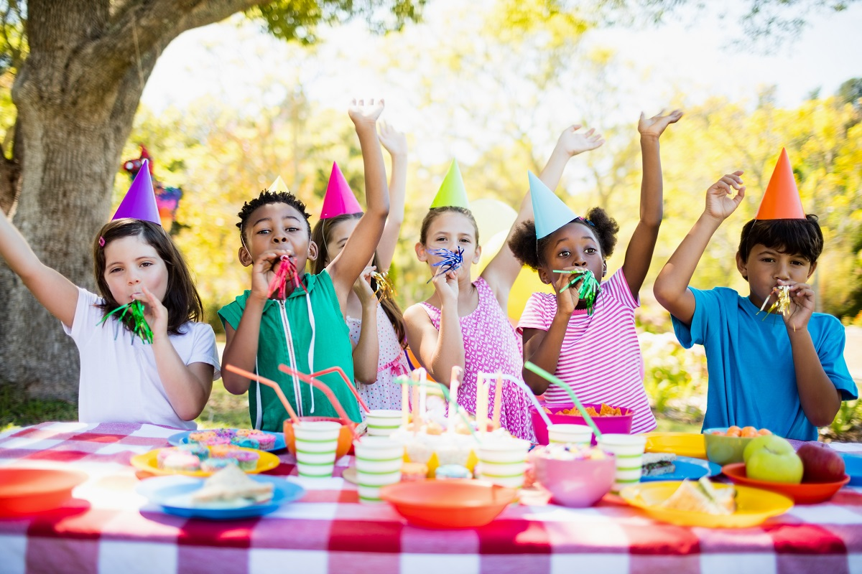
Unit 10
If you go to the party,
you’ll have a great time!

Slide 3



Slide 4





About your future, do you have any plan right now?
Do your parents have any plan for you, too?
Which of the things below are the most important to you? Circle 3 things and talk about 1.
____be happy ____ travel around the world
____go to college/get a further education
____make a lot of money ____ be famous
____get together with family ____ make my dream come ture
I think being happy, going to college and getting together with my family are the most important to me. Because being happy makes me feel that the life is meaningful.

Slide 5
Money is important.
Money is not the most important.
Before we become an adult(成年人), come out to the society(社会) and make money, there are also many things important for us to do, such as trying and taking on more things we are interested in and experiencing(经历) more as possible as we can.

Slide 6


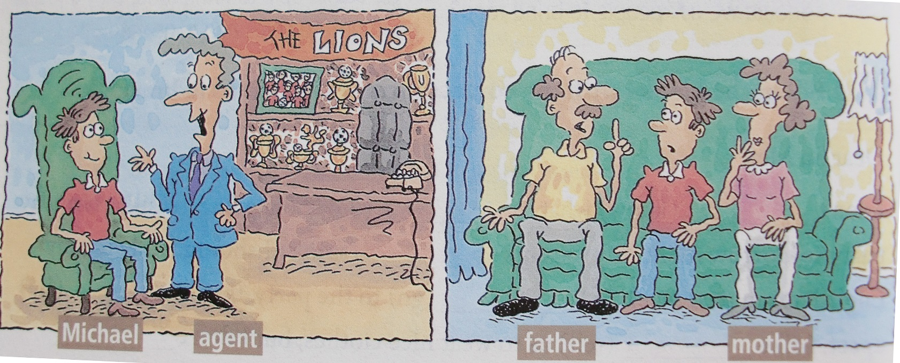
agent n. 代理人，经纪人
An agent is a person who gets work for an actor, a musician or a player, etc.
Who are they?
They’re Michael, the soccer agent and Michael’s parents.
What is The Lions?
It might be the name of a soccer team.
Which of the things are the most important to Michael and his parents?

Slide 7



Listen. Look at the list in 1a. Write A before each thing the soccer agent talks about and P before each thing Michael’s parents talk about.
be happy
travel around the world
go to college
make a lot of money
be famous
get an education
P
A
P
P
A
P

Slide 8

Listen again. Complete the sentences.
c
1. If you join the Lions, ____
2. If you become a Lion, ____
3. And if you work really hard, ____
4. If you become a soccer player, ____
5. But if I don’t do this now, ____
e
a. you’ll be famous.
b. I’ll never do it.
c. you’ll become a great soccer player.
d. you’ll never go to college.
e. you’ll travel around the world.
a
d
b

Slide 9
Read the conversations.
Conversation 1
Agent: The Lions are a great soccer team, you know!
Michael: Oh, I know.
Agent: If you join the Lions, you’ll become a great soccer player.
Michael: I’m sure I will. Will I travel much?
Agent: Sure! If you become a Lion, you’ll travel around the world.
Michael: Sounds great.
Agent: It is. And if you work really hard, you’ll be famous.
Michael: Well, I don’t know.

Slide 10
Conversation 2
Father: You shouldn’t join the Lions right now.
Michael: Why not?
Mother: If you become a soccer player, you’ll never go to college.
Michael: But I really want to play soccer. I want a job I love. I want to be happy.
Father: Of course you want to be happy, but there are many other interesting jobs out there.
Michael: But it’s my dream to play soccer with the Lions! This is really exciting!
Father: It is exciting. And I know you want to make a lot of money. But money isn’t everything, son.
Michael: I know. But if I don’t do this now, I’ll never do it.
Mother: But don’t you want to get an education?

Slide 11
Which of the things are the most important to Michael and
his parents?
In Michael’s opinions, making his dream come ture and being happy are the most important.
But Michael’s parents think going to college and
getting an education are the most important.

Slide 12





Student A is Michael. Student B is his friend. Student B, give Student A advice.
What do you think I should do? Can you give me some advice?
I think you should go to college.
But if I go to college, I’ll never become a great soccer player.

Slide 14
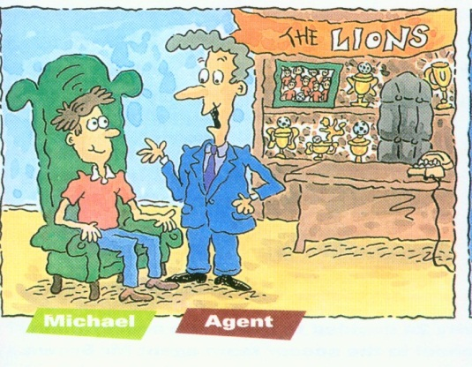
List the reasons the soccer agent and Michael’s parents mentioned to persuade him.
The agent
If you join the Lions,
you’ll become a great soccer player.
If you become a Lion,
you’ll travel around the world.
If you work really hard,
you’ll be famous.

Slide 15
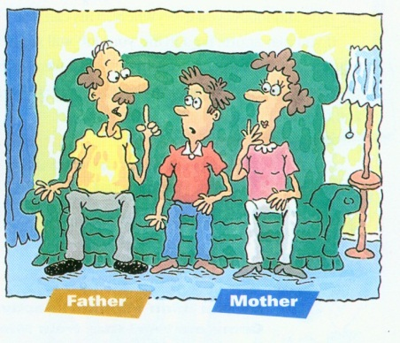
Michael’s parents
If you become a soccer player,
you’ll never go to college.
There are
many other interesting jobs out there.
Although playing soccer is exciting and can make a lot of money,
money isn’t everything.

Slide 16

Suppose you are Michael or Michael’s friends, try to use If…will… to write some sentences to predict the situation after joining the Lions.
1. If I join the Lions, I’ll have less free time.
2. If you become a famous soccer player, we won’t see you as often as we do now.

Slide 17


To think about the things that are most important to you
To listen to get the specific information about the advice given to Michael by a sports agent and his parents
To learn to give advice to others

Slide 18


Complete the sentences.
meeting, video, chocolate, taxi, upset, advice, organize
meeting
1. If you walk there, you’ll be late for the ________.
2. If they watch a(n) ________ at the party, some students will be bored.
3. I don’t know what to do, can you give me some _________?
video
advice

Slide 19
meeting, video, chocolate, taxi, upset, advice, organize
4. What will happen if she _________ a soccer game on Saturday?
5. If she doesn’t come home on time, her parents will be ________.
6. If it rains tomorrow, we’ll take a(n) ________ there.
7. If he eats too much _________, he’ll be very heavy.
organizes
upset
taxi
chocolate

Slide 20


Why do you think these things are the most important to you? Give your reasons. Then ask your group members.
I think being happy is the most important because it makes me feel that the life is meaningful…
…thinks going to college is the most important to her/him. If she/he goes to college, she/he will find a good job.

Slide 21
Look at the pictures and think about:
Where is it?
Who are the two people?
What is The Lions?
The Lions might be the name of a sports team.
Michael and an agent.
n. 代理人，经纪人

Slide 22
What’s the relationship of the three people? What do you think they’re talking about?
Michael and his parents may talking about things that are important to Michael.

Slide 23

A: I think you should go to college.
B: Why?
A: Because if you go to college, you’ll get a good education.
B: Why is a good education important?
A: If you get a good education, you can get a good job.
B: But being a soccer player is a great job. And if I go to college, I’ll never become a great soccer player.
A: But if you go to college, you can get a good education and play soccer on the school team.
B: But if I play on the school team, I won’t develop professional skills, and I won’t earn money.

Slide 24


travel v. ①旅行；游历
travel around the world 环游世界
travel to ... (去……旅行)中
② (以某速度、朝某方向或在某距离内)行进，传播
e.g. They travelled 200 miles on the first day.
他们第一天走了 200 英里。
n. 旅行；游历，泛指一切旅游
e.g. Air travel is becoming cheaper.
乘飞机旅行越来越便宜。

Slide 25
【链接】
trip也有“旅行”的意思，指往返的旅行，尤指娱乐性的短途旅行，常用于短语go on / take a trip中。
【语境应用】完成句子
1) 她每天走两英里去上班。
She ______________________ to work each day.
2) 光比声音传播得快。
Light ______________________ than sound.
3) 我们计划今年夏天去杭州旅游。
We are planning to ______________________ Hangzhou this summer.
travels / walks two miles
travels faster
travel / go on a trip /
take a trip to

Slide 26


上大学
周游世界
赚许多钱
接受教育
go to college
travel around the world
make a lot of money
get an education

Slide 27


根据短文内容及所给词的提示填空。
Hello, I’m John. I (1)__________(want) to become a pilot like my friend. I think he looks cool when he (2)__________(wear) his pilot uniform. If I become a pilot, my parents (3)_________ (be) proud (自豪的) of me and I (4)__________ (travel) around the world. I am tall and of medium build. I (5)__________(be) quite healthy and strong. I like playing sports.
want
wears
will be
will travel
am

Slide 28
study/
am studying
Also, I (6)___________(study) hard at school. If I (7)__________(have) a chance (机会) to become a pilot, I will have a great time flying in the blue sky. I (8)__________ (believe) I can be an excellent pilot.
have
believe

Slide 29


Make a conversation according to 1d.
Preview the passage in 2b.

Slide 30


